Slide 1

OLIST E-COMMERCE Seller Performance Analysis
By Promise Ezeike
Data Analyst, March 2026

Slide 2
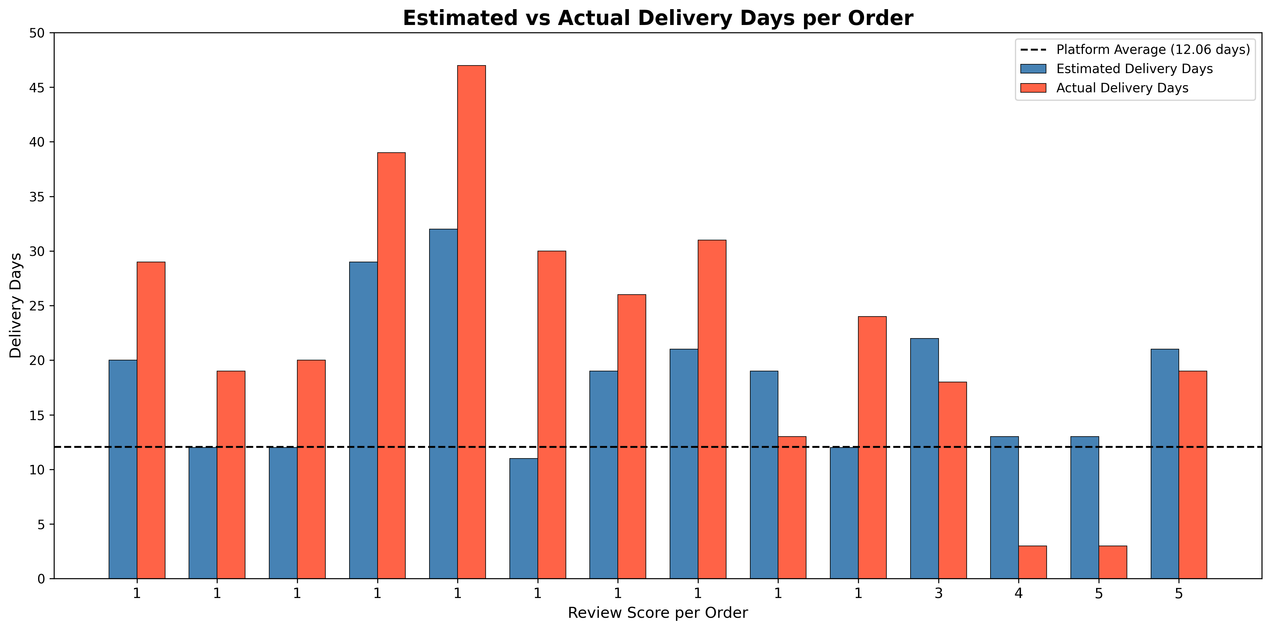
ESTIMATED VS ACTUAL DELIVERY DAYS
The orders with rating of 1 has longer actual delivery than the estimated delivery days resulting in the low reviews (red columns longer than blue)
The orders with reviews, 3, 4 and 5 received their orders well before the estimated delivery days (blue columns longer than red)

Slide 3
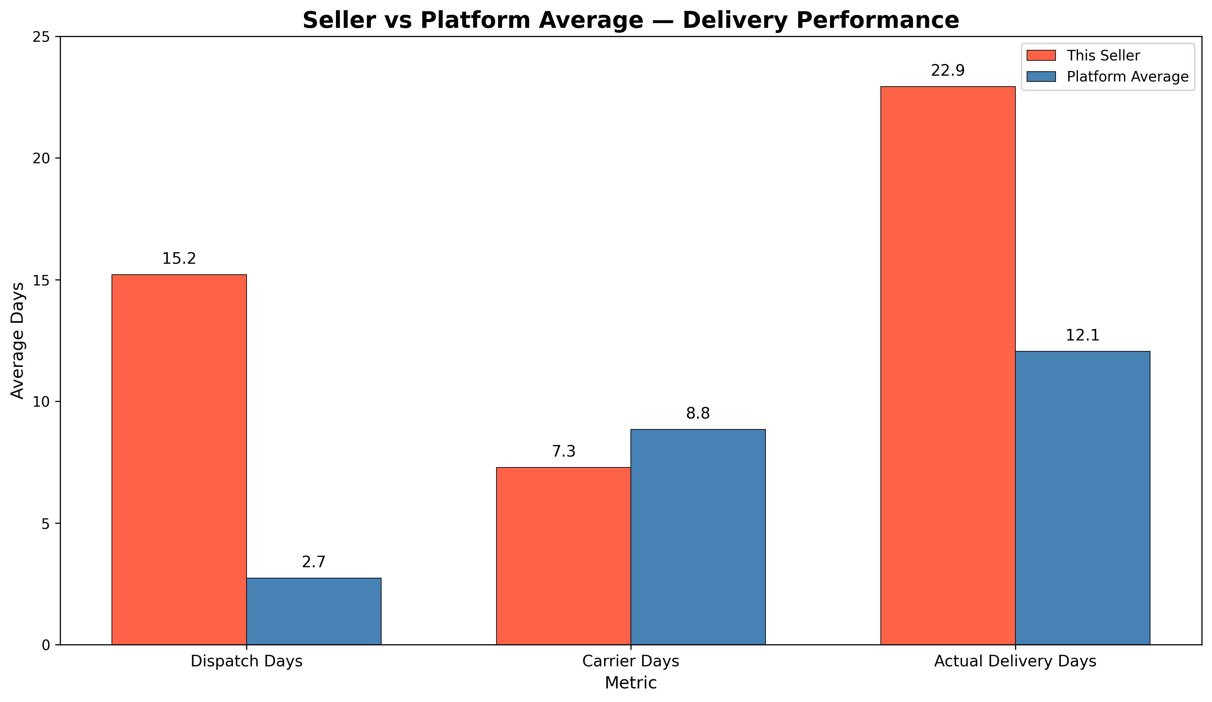
SELLER VS PLATFORM DELIVERY
The average actual delivery days of the seller is 22.9 days against the platform’s average of 12.1
The seller’s carrier days is not the problem as it takes 8.8 days against the platform’s 7.3
The seller’s dispatch is about 5.6 times longer than other sellers on the platform with 2.7 days

Slide 4
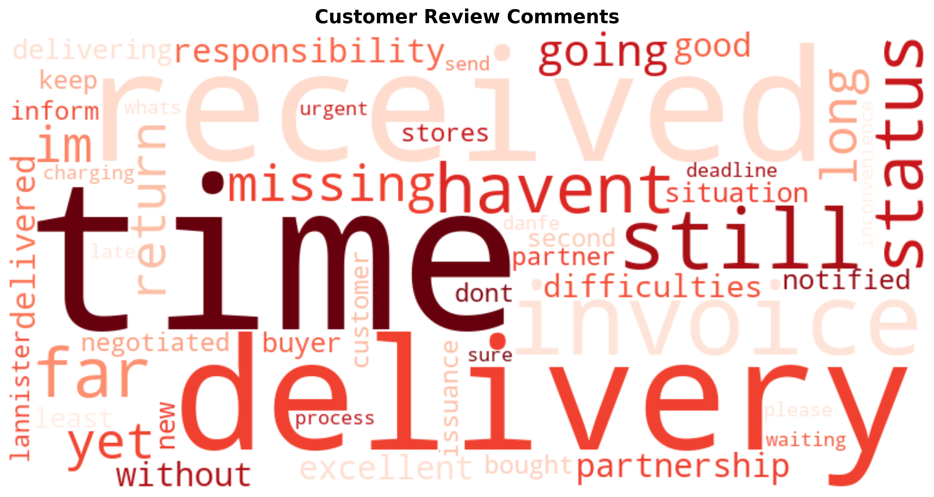
CUSTOMERS COMMENTS CONCENTRATION
It can be deduced that the comments made by the customers are tilted towards the seller’s delivery time, and responsibility, poor responsibility and not product quality

Slide 5
RECOMMENDATION
Set a maximum dispatch time threshold of 3 days — aligned with the platform average of 2.74 days
Monitor this seller's dispatch compliance weekly for 90 days
Provide the seller with their performance data and platform benchmarks
Issue a formal warning if dispatch time exceeds 5 days on any order
Review removal only if dispatch performance does not improve within 90 days

